Slide 1


Slide 2
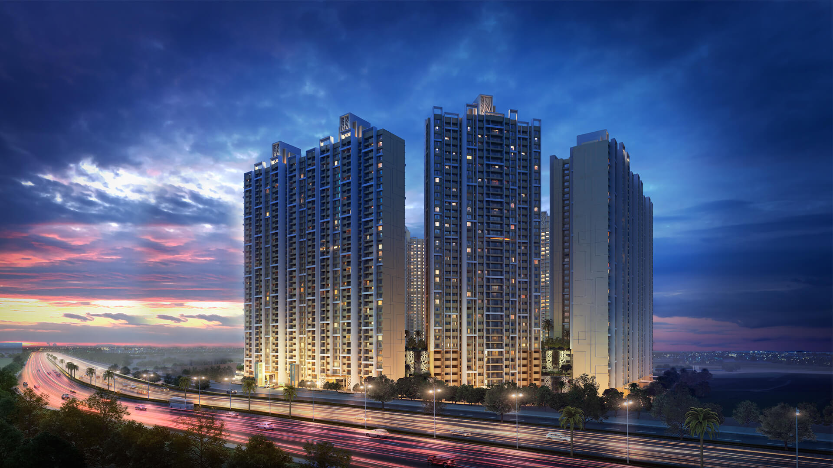
About team
NAME: Anil Eagala
QUALIFICATION:MBA(finance)
NAME: Srikanth Swargam
QUALIFICATION:MSC(APPLIED-STATISTICS)

Slide 3

WEB SCRAPPING AND EXPLORATORY DATA ANALYSIS ON
Sub Titile

Slide 4
Key takeaways:
Business problem
Website used
Features
Libraries imported
Data frame creation
Data cleaning
Data frame after cleaning
Summery statistics
Univariate analysis
Bi variate / multivariate analysis
conclusion

Slide 5
BUSINESS PROBLEM:
Analysis the Price variation, availability and Rate/Sq. Ft for various areas location around Visakhapatnam.

Slide 6
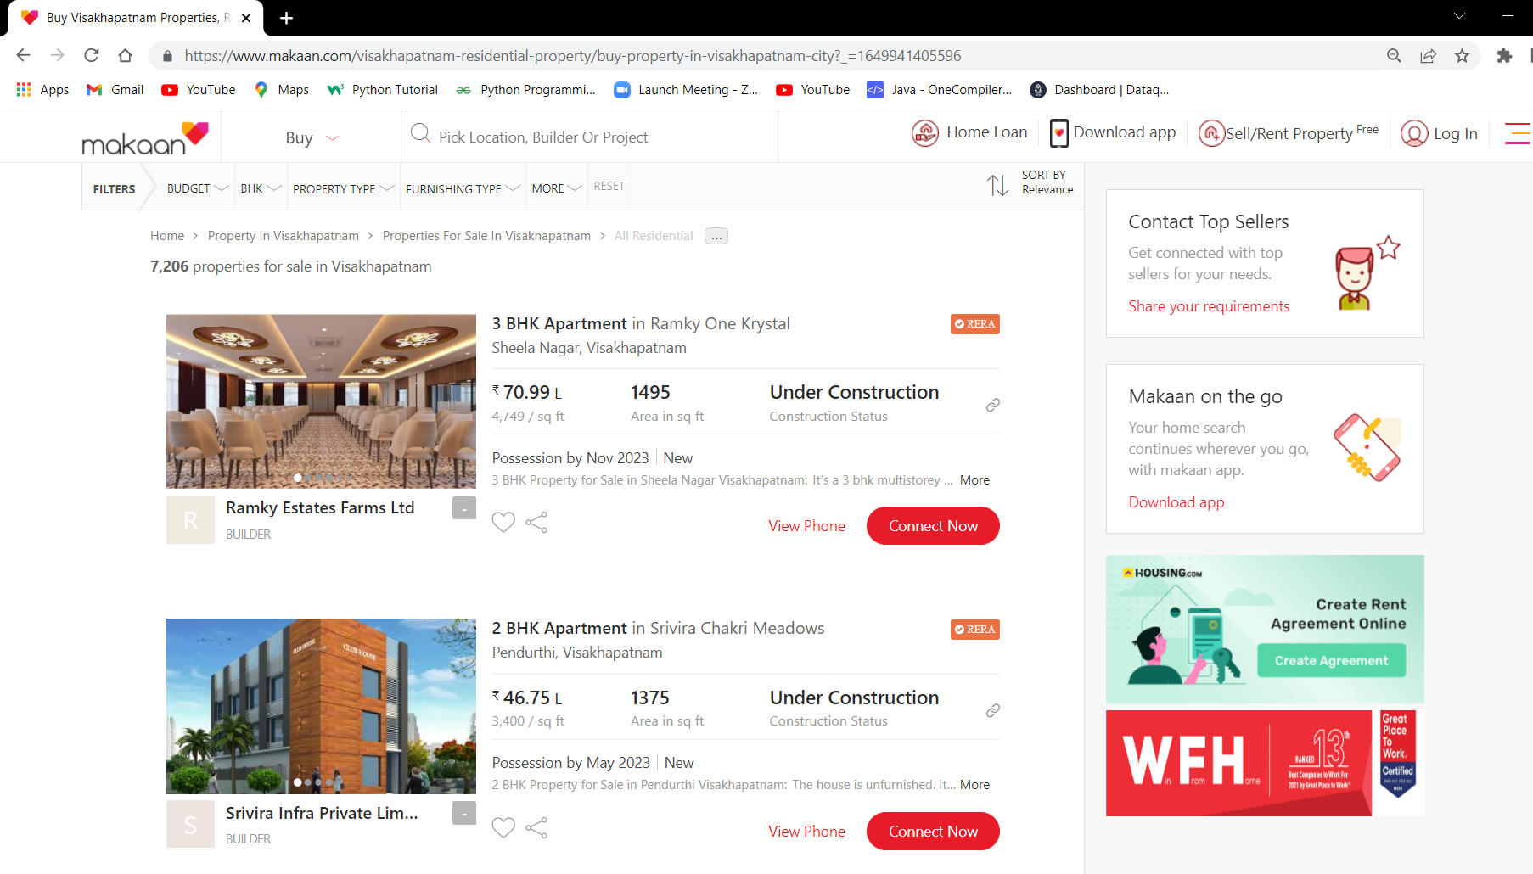
website:

Slide 7
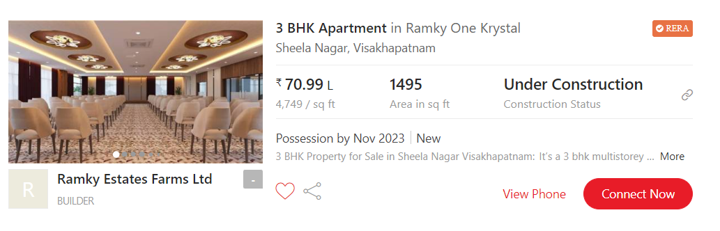
FEATURES: 1.price 2.status 3.Area 4.Rate per Sq. ft 5.location 6.property_type 7.seller 8.RERA 9.possession by

Slide 8
IMPORTING THE LIBRARIES
Libraries:
NumPy
Pandas
Matplotlib
Seaborn
Requests
re
Bs 4/ Beautiful Soup
csv

Slide 9
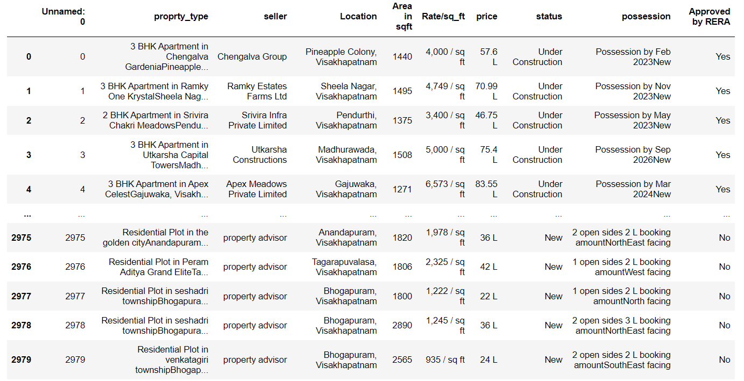
CREATION OF DATAFRAME

Slide 10
DATA CLEANING
Identifying Null Values.
Identifying Missing Values.
Treating rows and columns with null values and missing values.
Extracting required data from columns to create another columns using regular expressions.
Treating columns and converting required columns from object to int or float datatype.

Slide 11
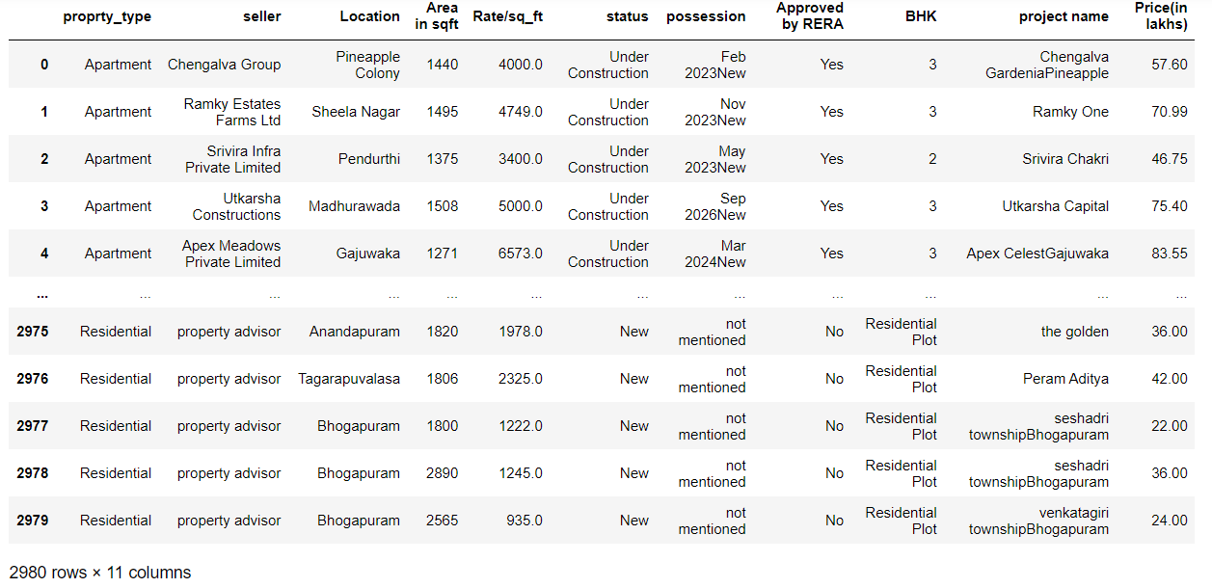
DATAFRAME AFTER CLEANING

Slide 12
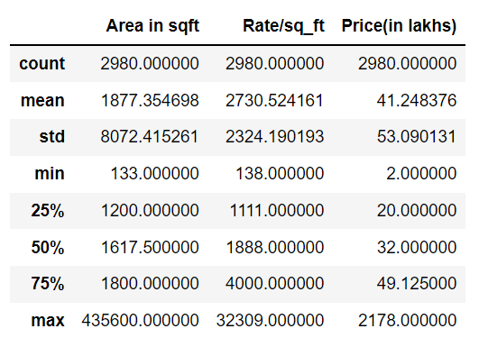
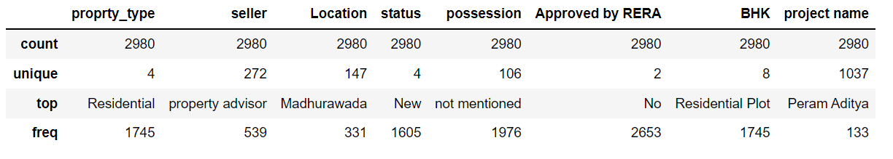
Summary statistics of Data Frame:

Slide 13

VISUALIZATION

Slide 14
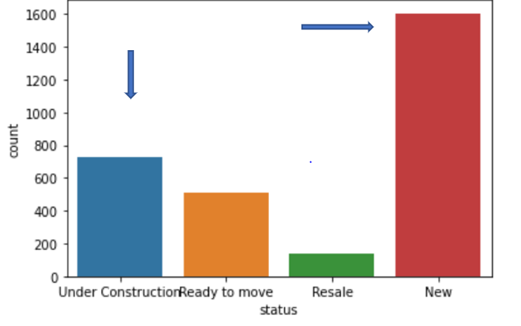
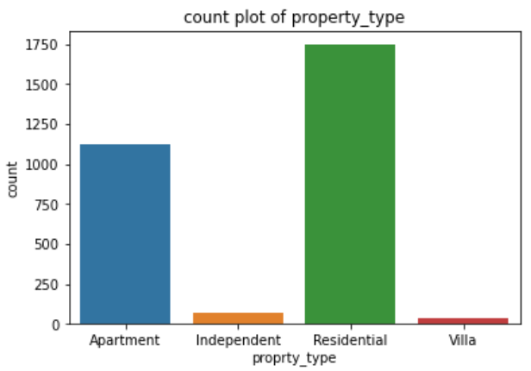
# STATUS
More number of constructions are being made as Newly available plots and Under construction projects are more.
#PROPERTY TYPES
Highest number of properties are divided in between Apartment and Residential type.

Slide 15
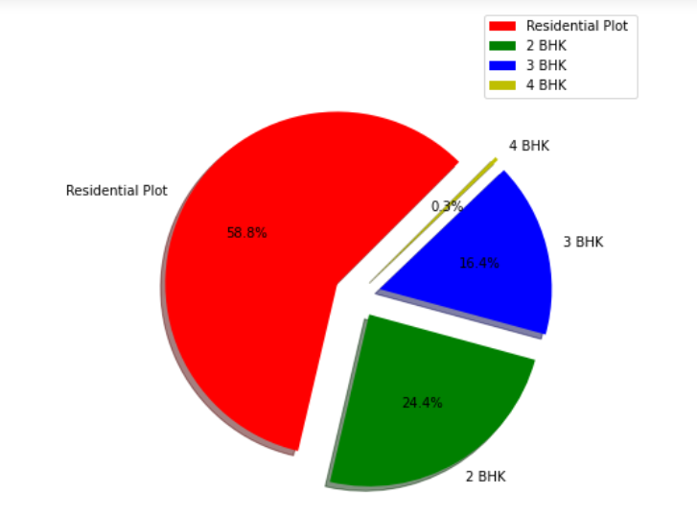
Property types
There are more number of residential plots available in, Coming to apartments 2 BHK are highly available.

Slide 16
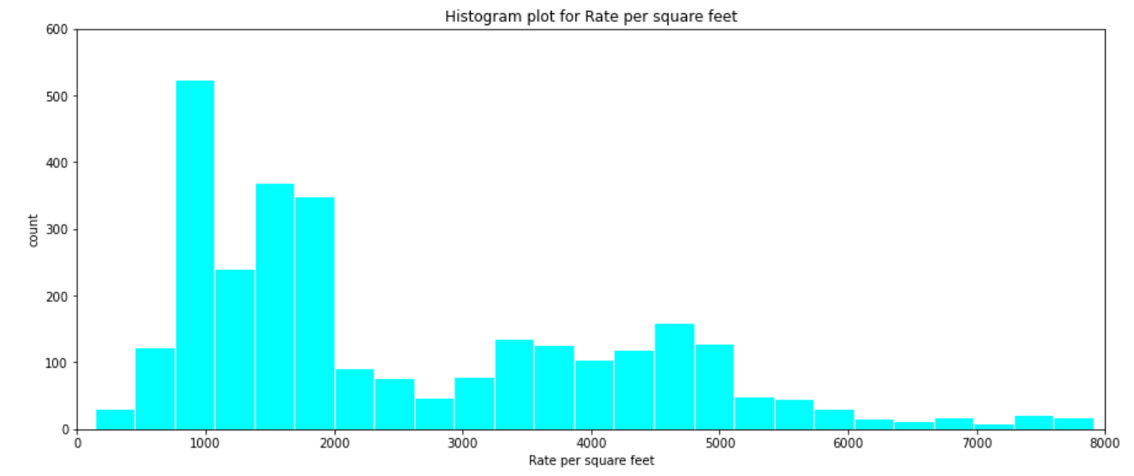
Rate per Sq. Ft analysis
Most number of the plots comes in the range between 900 and 2000Rs/ sq. Ft.
The number of plots with higher than 5000 sq. Ft are very less.

Slide 17
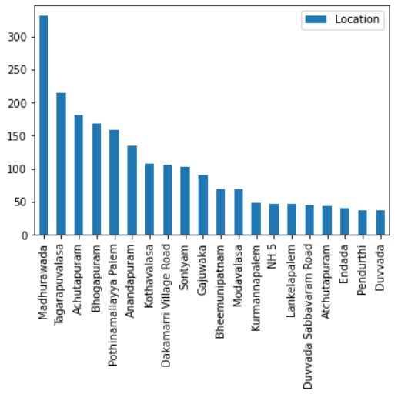
NO OF PROPERTIES IN LOCATION:
Madhurawada and tagarapuvalasa locations has highest number of plots.

Slide 18
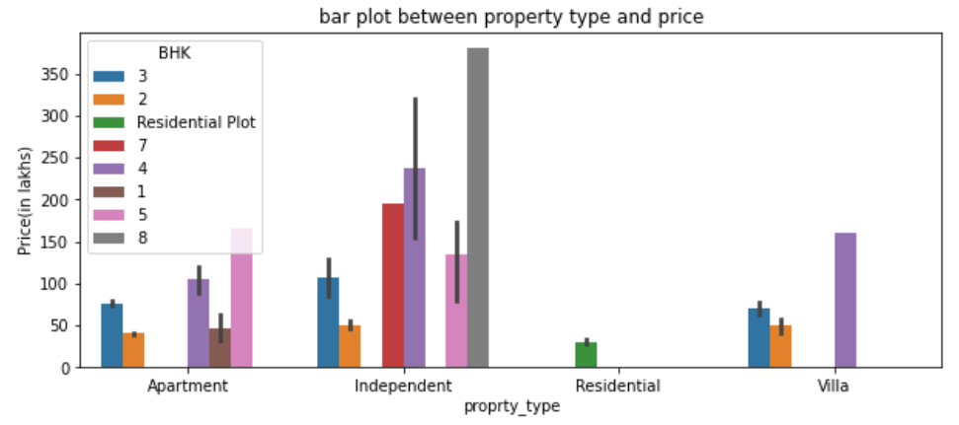
Property type and Price
Average prices of Apartments are in range of 40L to 165L.
Average prices of independent house available in range of 51L to 380L
Residential plots available for an average of 30L.
Average prices of villas available in range of 50L to 160L.

Slide 19
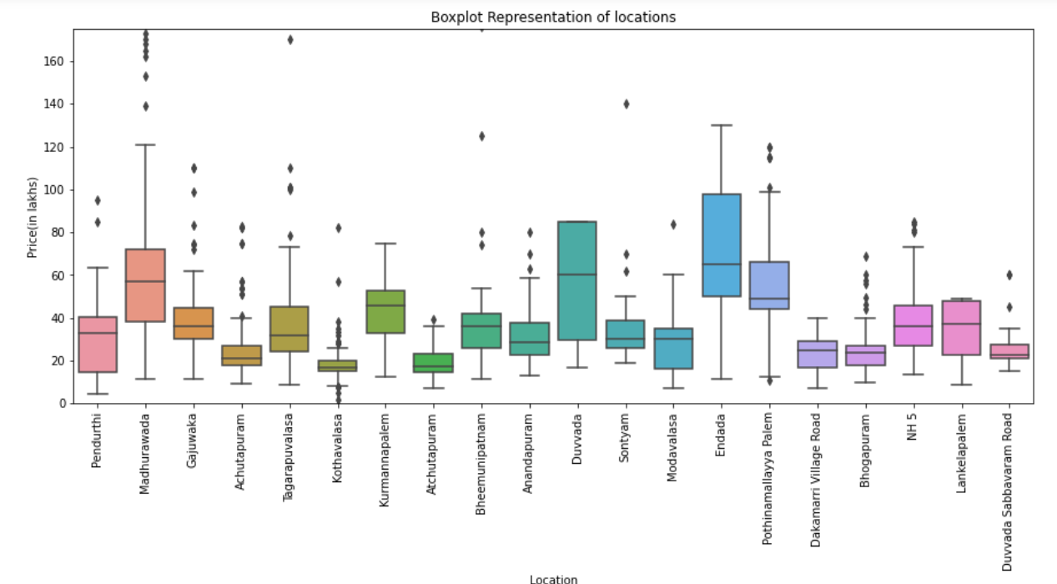
Location and Price relation analysis
We can define that Higher prices are in MADHURAWADA and lowest prices are in KOTHAVALASA location. Average prices of Madhurawada, Duvvada and Endada are in the same price range.

Slide 20
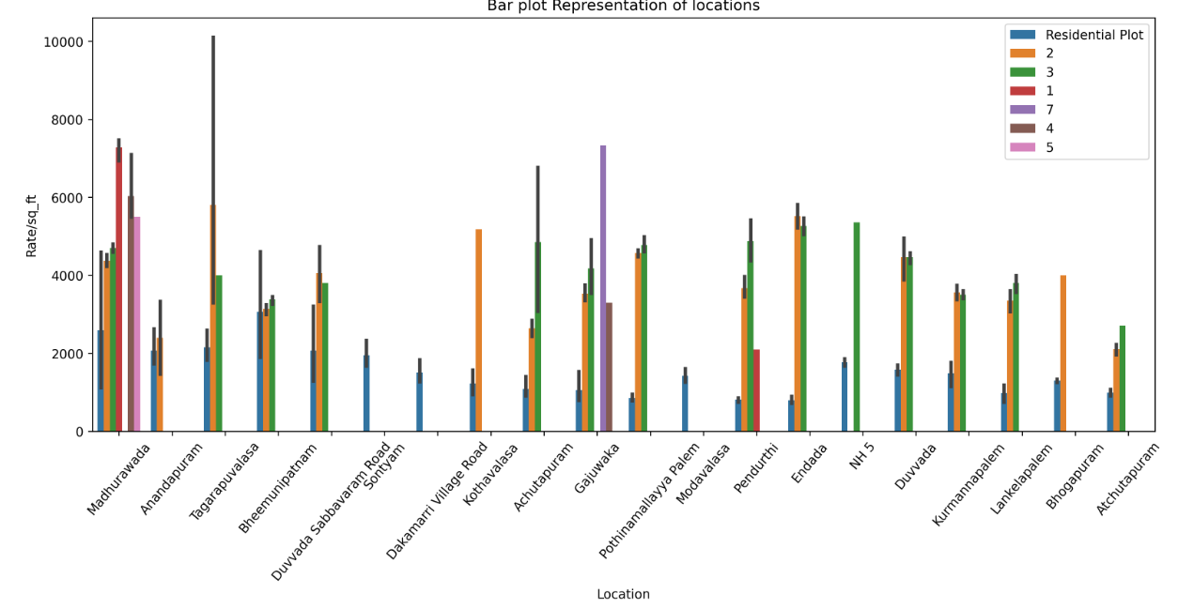
Different rates per sq ft diff locations

Slide 21
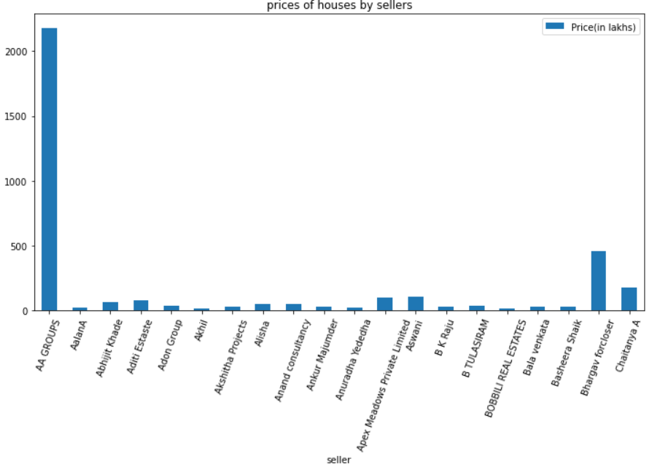
AA groups provides most luxury plots as they outpowered other groups in terms of costing they sell.
Comparing the prices by sellers:

Slide 22
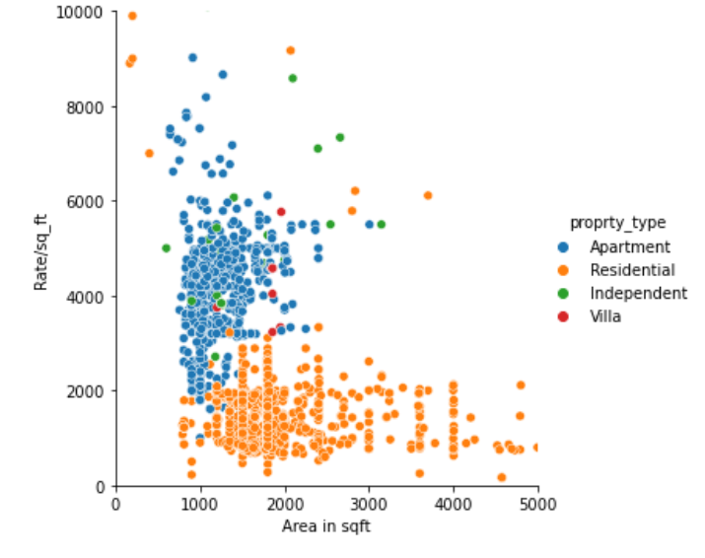
Relation plot For Area And Rate Per Sq. Ft
The area and rate per sq. Ft are positively positively correlated for apartments and Residentials.
For Villas and Independent houses are less positively correlated.

Slide 23
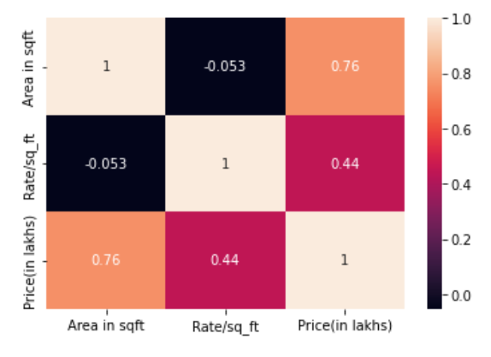
Correlation Map
Area and price are highly correlated.
Area and rate per sq. Ft are less correlated.

Slide 24
CONCLUSION :
• We can compare the data with new data periodically ,to know the growth and development of an area ,for future investments or buying a property at developing area at a minimal price.

Slide 25

Thank
YOU

